Slide 1
Kitale,Kenya PD Summer 2019
Inspiring Teachers to Impact Learners
Dr. Timothy Makubuya
Health & Physical Education
College of Education
University of Missouri- St. Louis

Slide 2
Greetings
Hello
Muli mutya
Hola
Namaste
Niatia
Habari

Slide 3
Uganda before 1910
Notes:
Library of congress

Slide 4
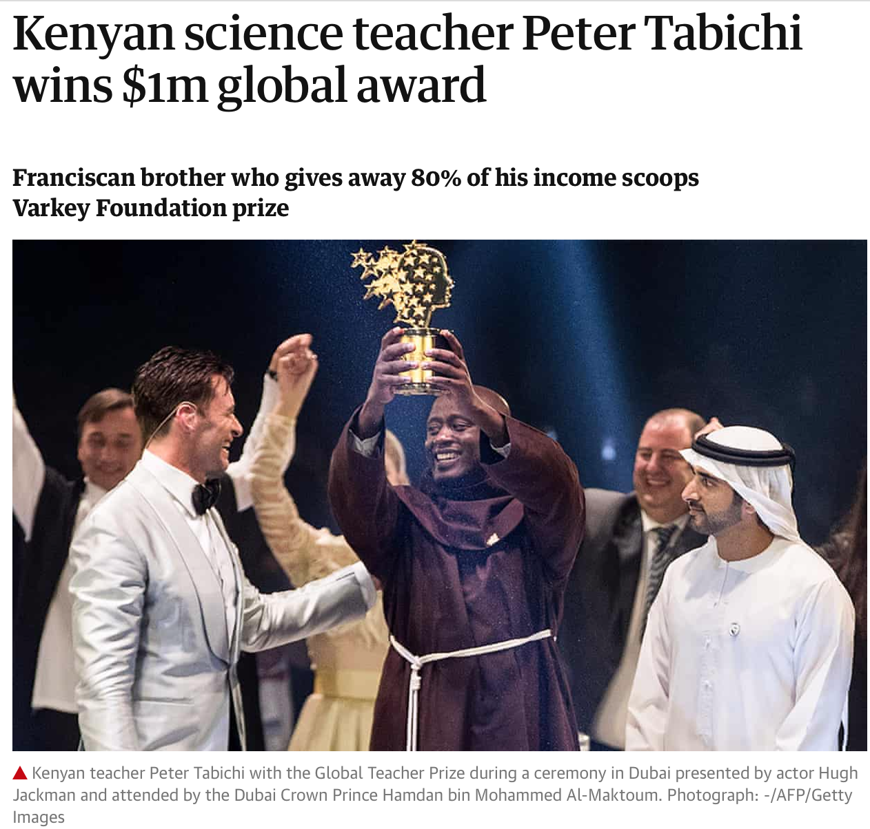
Celebrate Mwalimu Success
“More than 90% of his pupils are from poor families and almost a third are orphans or have only one parent. Drug abuse, teenage pregnancies, dropping out early from school, young marriages and suicide are common. Students have to walk 7km along roads that can become impassable in the rainy season to reach the school and the area can be affected by drought and famine.” Guardian
Notes:
https://www.globalteacherprize.org/winners/andria-zafirakou/

Slide 5
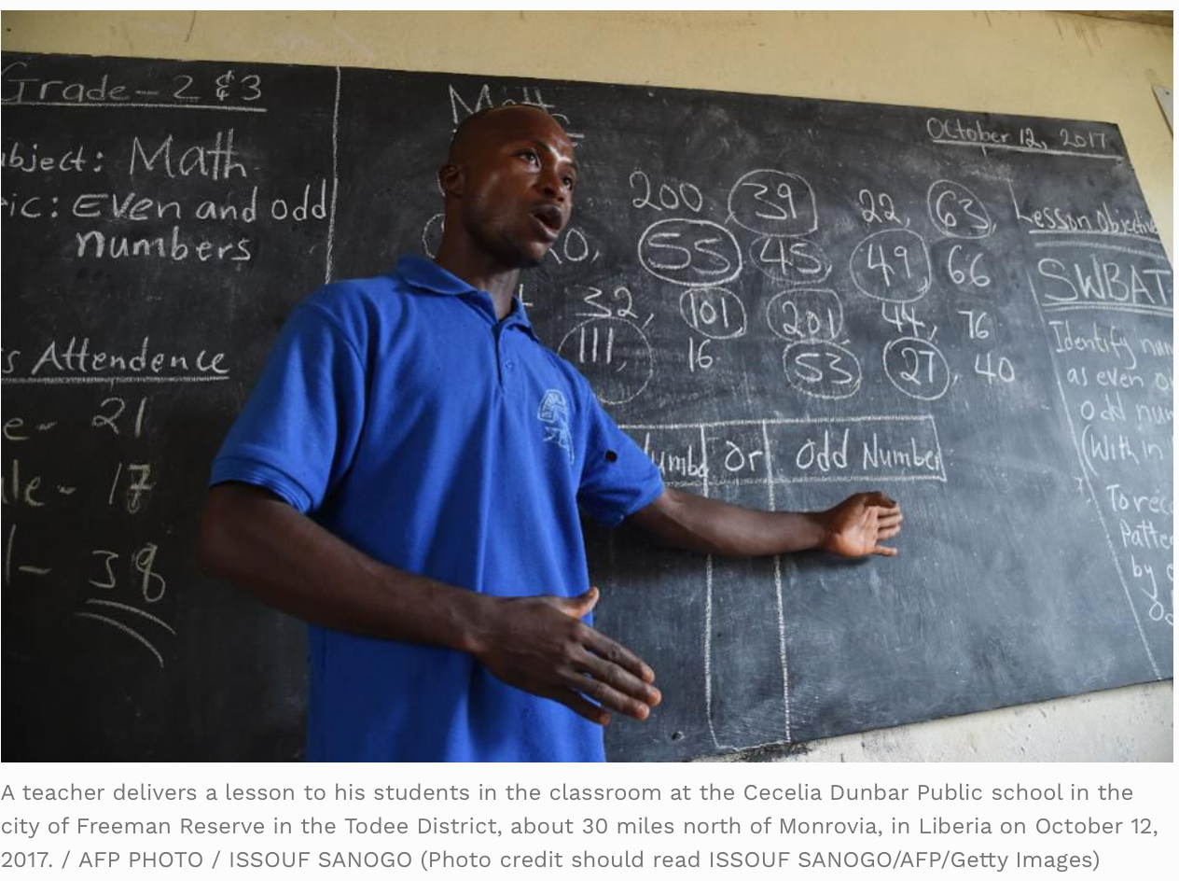
More Success

Slide 6
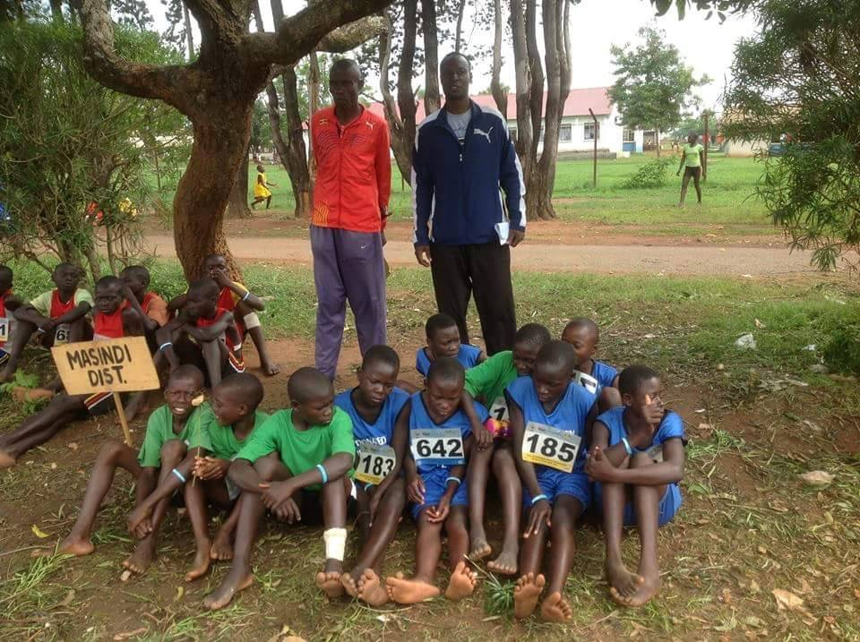
Extra Curricular Activities
Great Teachers Inspire Participation in Activities
They too Do NOT use Exercise as punishments

Slide 7
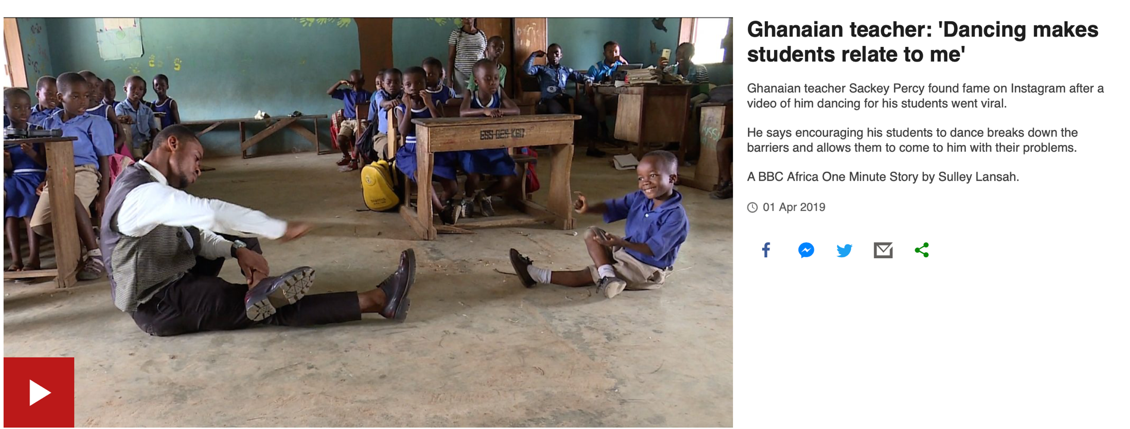
Using Music as a Pedagogical Tool
Putting your talents at good use for the benefit of your students
Notes:
https://www.bbc.com/news/video_and_audio/headlines/47751266/ghanaian-teacher-dancing-makes-students-relate-to-me

Slide 8
Short Group Activity
How do you inspire pupils/students in your classroom?
How do you inspire pupils/students outside classroom?
How do you inspire pupils/students in your school?

Slide 9
How do you want to be Inspired?
What inspires you?
How can you as a head of department inspire teachers in your department?
How can you extend acts of inspiration to your leaners?
How should school leaders inspire us?
What can families and communities do?
Can our pupils/students too inspire us?

Slide 10
Preparing the Whole Child
Whole School Whole community Whole Child Model
https://www.youtube.com/watch?v=1vXo584fb1M
Notes:
https://www.youtube.com/watch?v=1vXo584fb1M

Slide 11
Rethinking our Teaching
How important is letting children get a break from learning ?
What evidence do we have available to support the need for movement?
Using all kinds of movements as a break and recuperation but NOT a punishment.
Movement activities for successful teaching in non- physical education settings.

Slide 12
Challenges in Classrooms
Why are these pupils misbehaving?
Why the need for Movement?
Do brain Breaks work?
Can we create Healthy Classes & other learning environments?

Slide 13
Benefits of Getting up and Moving
Yes, Yes & Yes Physical activity improves cognition, academic performance (better grades), memory and classroom behaviors.
https://www.cdc.gov/healthyschools/physicalactivity/facts.htm

Slide 14
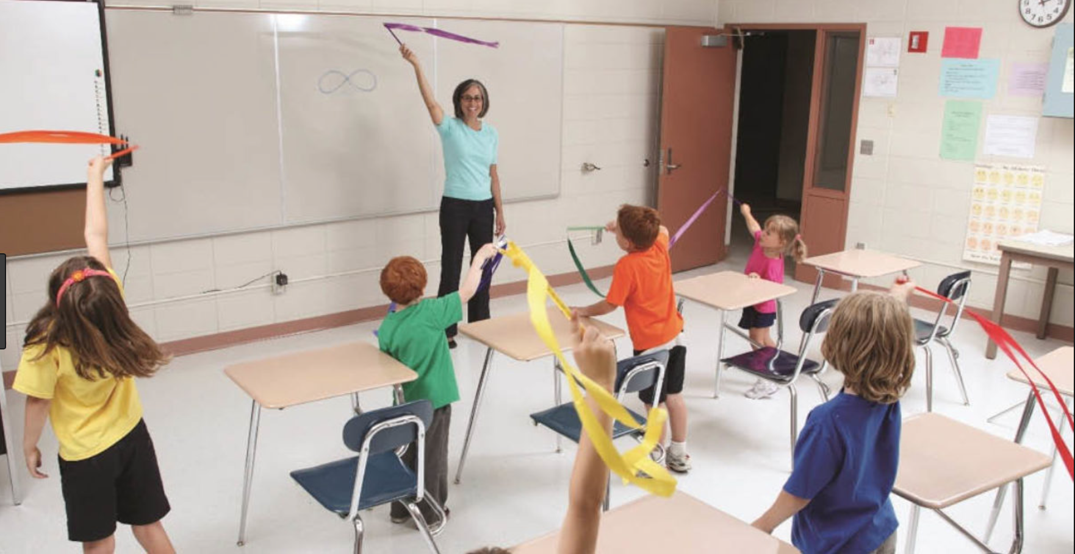
Attention Span
Tan, B. W. Z., Cohen, L., & Pooley, J. A. (2013). Physical activity: Its implication on attention span and quality of life in children with autism spectrum disorders. Journal of Law and Social Sciences, 2(2), 108–116. https://doi.org/10.5176/2251-2853_2.2.121

Slide 15
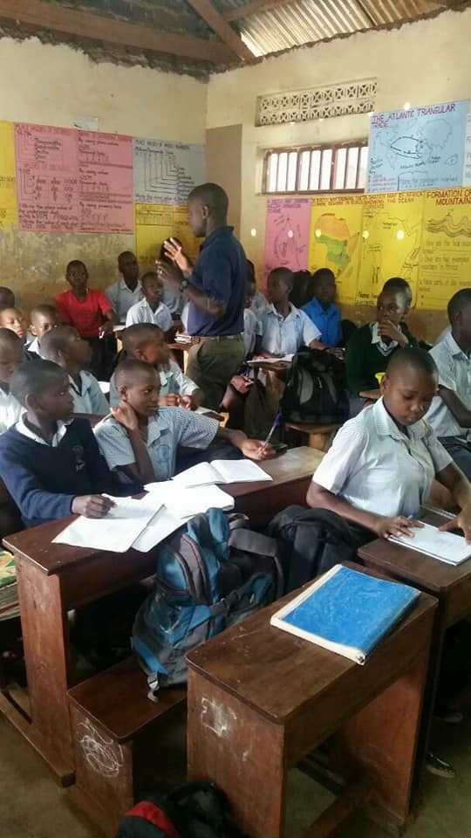
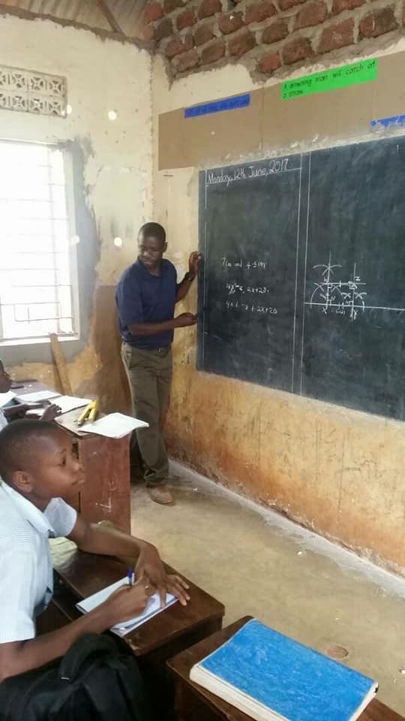
African Classroom Settings

Slide 16
If Movement Improves Work performance, What about School Performance?
Labonté-Lemoyne, É., Santhanam, R., Léger, P. M., Courtemanche, F., Fredette, M., & Sénécal, S. (2015). The delayed effect of treadmill desk usage on recall and attention. Computers in Human Behavior, 46, 1–5

Slide 17
Do we all need a Break From Learning?
Brain Breaks
“ALL schools can afford daily PE, AND WE can encourage Physical Activity and other forms of Movements through out the school day.
Never Take away Recess as a disciplinary action
Encourage children to be active by offering more recess through out the week as a reward.
Remember that even people in the work environment take a break and movement has been proven to increase work performance.

Slide 18
Movements teachers can Use in a General Class Setting
Brain Break Resources and Websites
Brain Dance in Action: Alphabet Rockers Classroom Activity for Kindergarten
https://www.youtube.com/watch?v=cNBWZd5BgtU
Ann G. Gilbert
Ann’s Teaching Tribute (2016)
https://www.youtube.com/watch?v=003KTf598Rg
Fit Hop Brain Dance for young children - ages 6-10
https://www.youtube.com/watch?v=9-s-muS_uJs
Kigulu Primary school in Kibera, Nairobi (Kenya)
https://youtu.be/GTmuEUyEV8I

Slide 19
Examples of Activities for Healthy Classrooms & School
Background on Physical Health (Lung, Heart, Body Composition).
Incorporating Step ups and heart rate during class
Incorporate jump and jacks and determine heart rate
Dance activities.

Slide 20
Practical Applications
Can you share your classroom teaching experiences to inspire others?- Audience
Can you share your out of class experiences with students or fellow teachers to inspire others?- Audience

Slide 21
END
Questions ????????

